Slide 1

PhD Supervisors Meeting
01/03/24

Slide 2



Agenda
EXPLORING RESEARCH
QUESTIONS
SYSTEM GRAPHIC
WHAT IS NEXT?

Slide 3
Exploring Research Questions

Slide 4
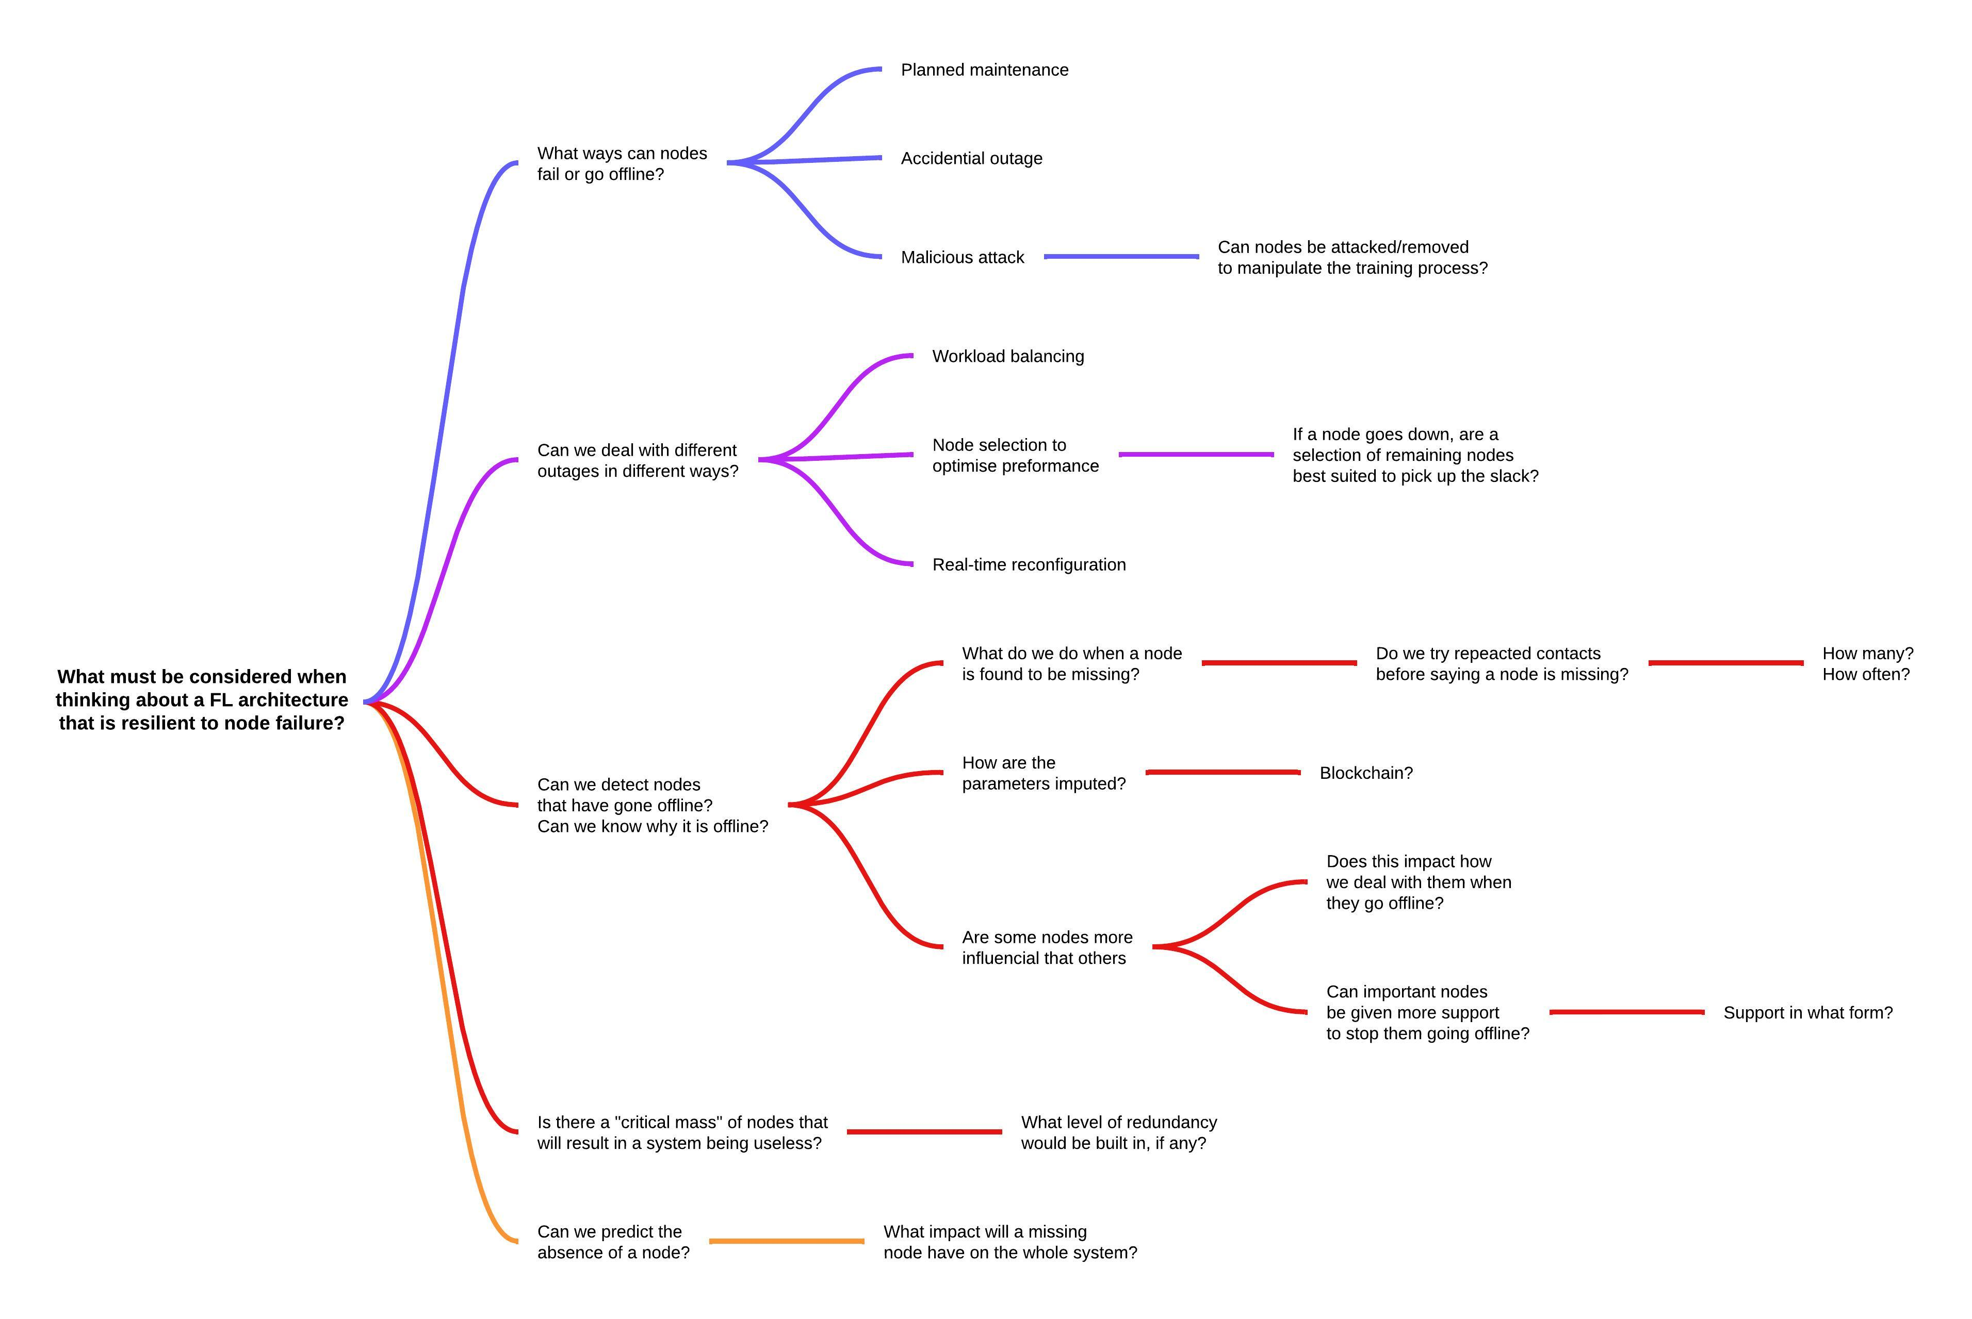
Research Question 1
In any large distributed network, there is a chance that some nodes can be lost, for a range of reason. Can a FL architecture be designed to be resilient, allowing it to identify missing nodes, and adapt so that there is no loss in performance?
How do we deal with missing nodes? Does the way a node went missing determine what we do?
What different ways can nodes go offline? Can we detect if a node is offline?
Are some nodes more likely to go offline than others? Can we predict this?
Can ML/FL models be made adaptable to missing nodes? Can other nodes pick up the slack?
Are some nodes more likely to go offline than others? Can we predict this?
Will some nodes have more of an influence than others? Do they get more support?

Slide 5
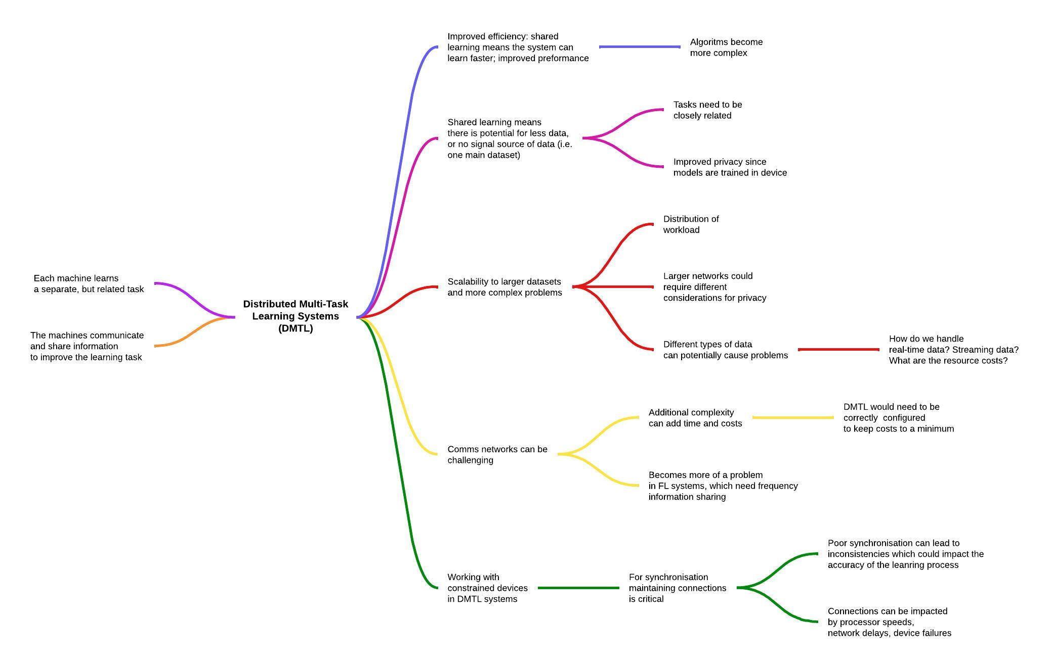
Research Question 2
Can we design FL systems that work within a distributed multi-task learning system?
Distributed systems could require a different communications systems (LoRa?)
Allows for larger, more complex problems to be tackled
Distributed systems can have benefits in privacy – there is no single source of data
Shared learning can lead to a more efficient systems, which can lead to improved performance?
Working with constrained devices in a DMTL system will require synchronization in connections

Slide 6
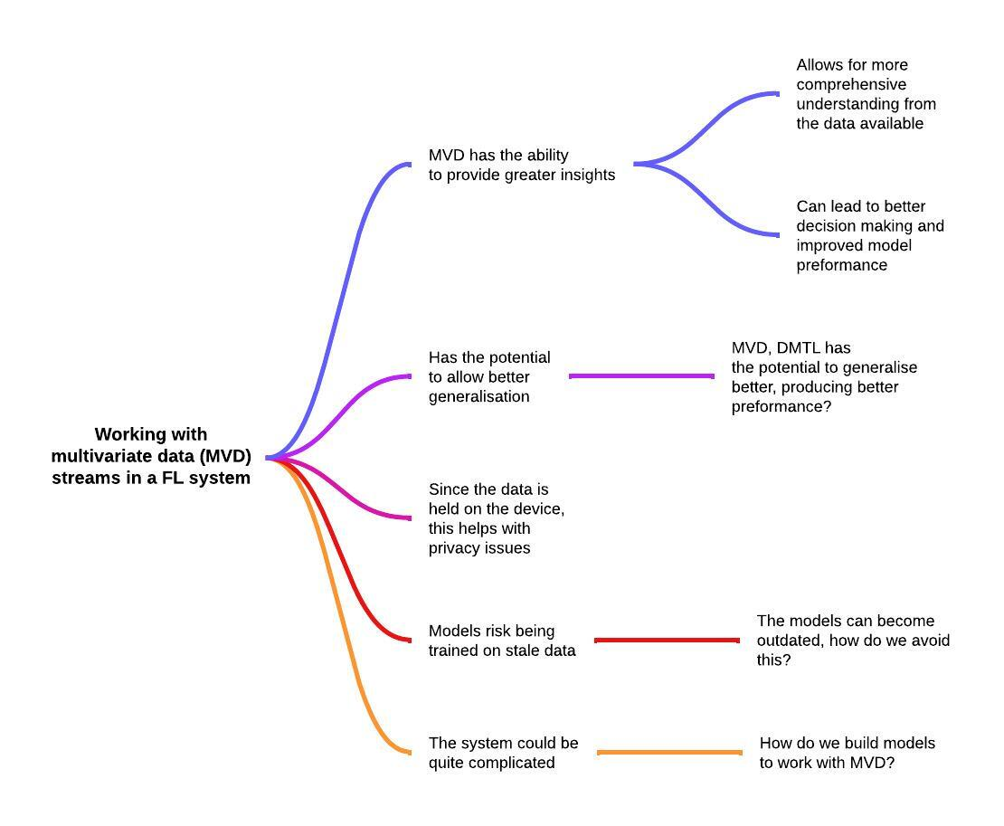
Research Question 3
Can we introduce multivariate data (MVD) to a FL network? What must be considered when working with MVD?

Slide 7
Federated Learning System Graphic

Slide 8
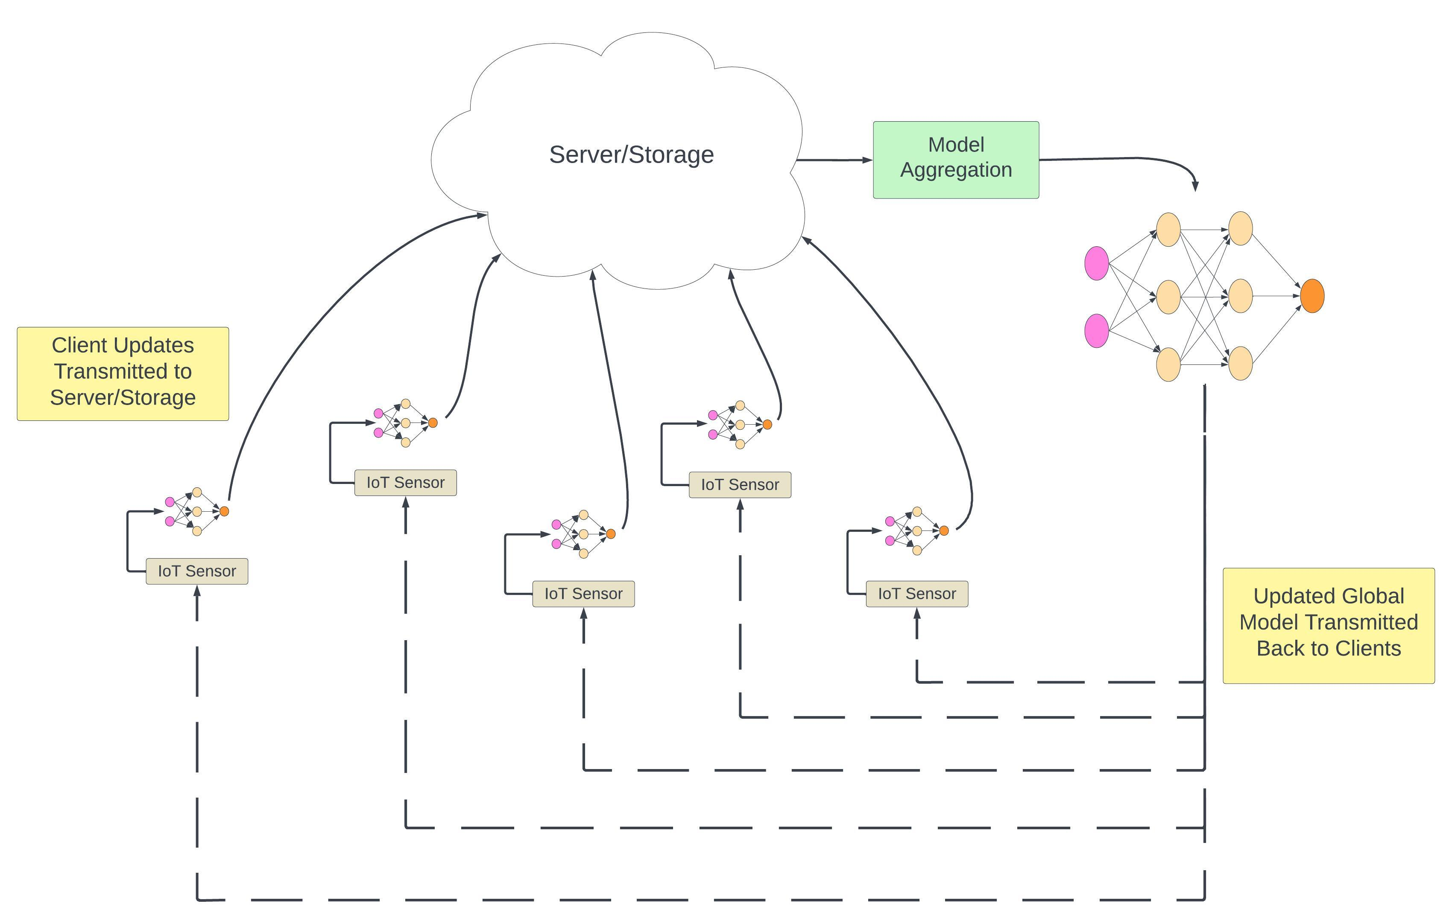
Federated Learning Diagram

Slide 9
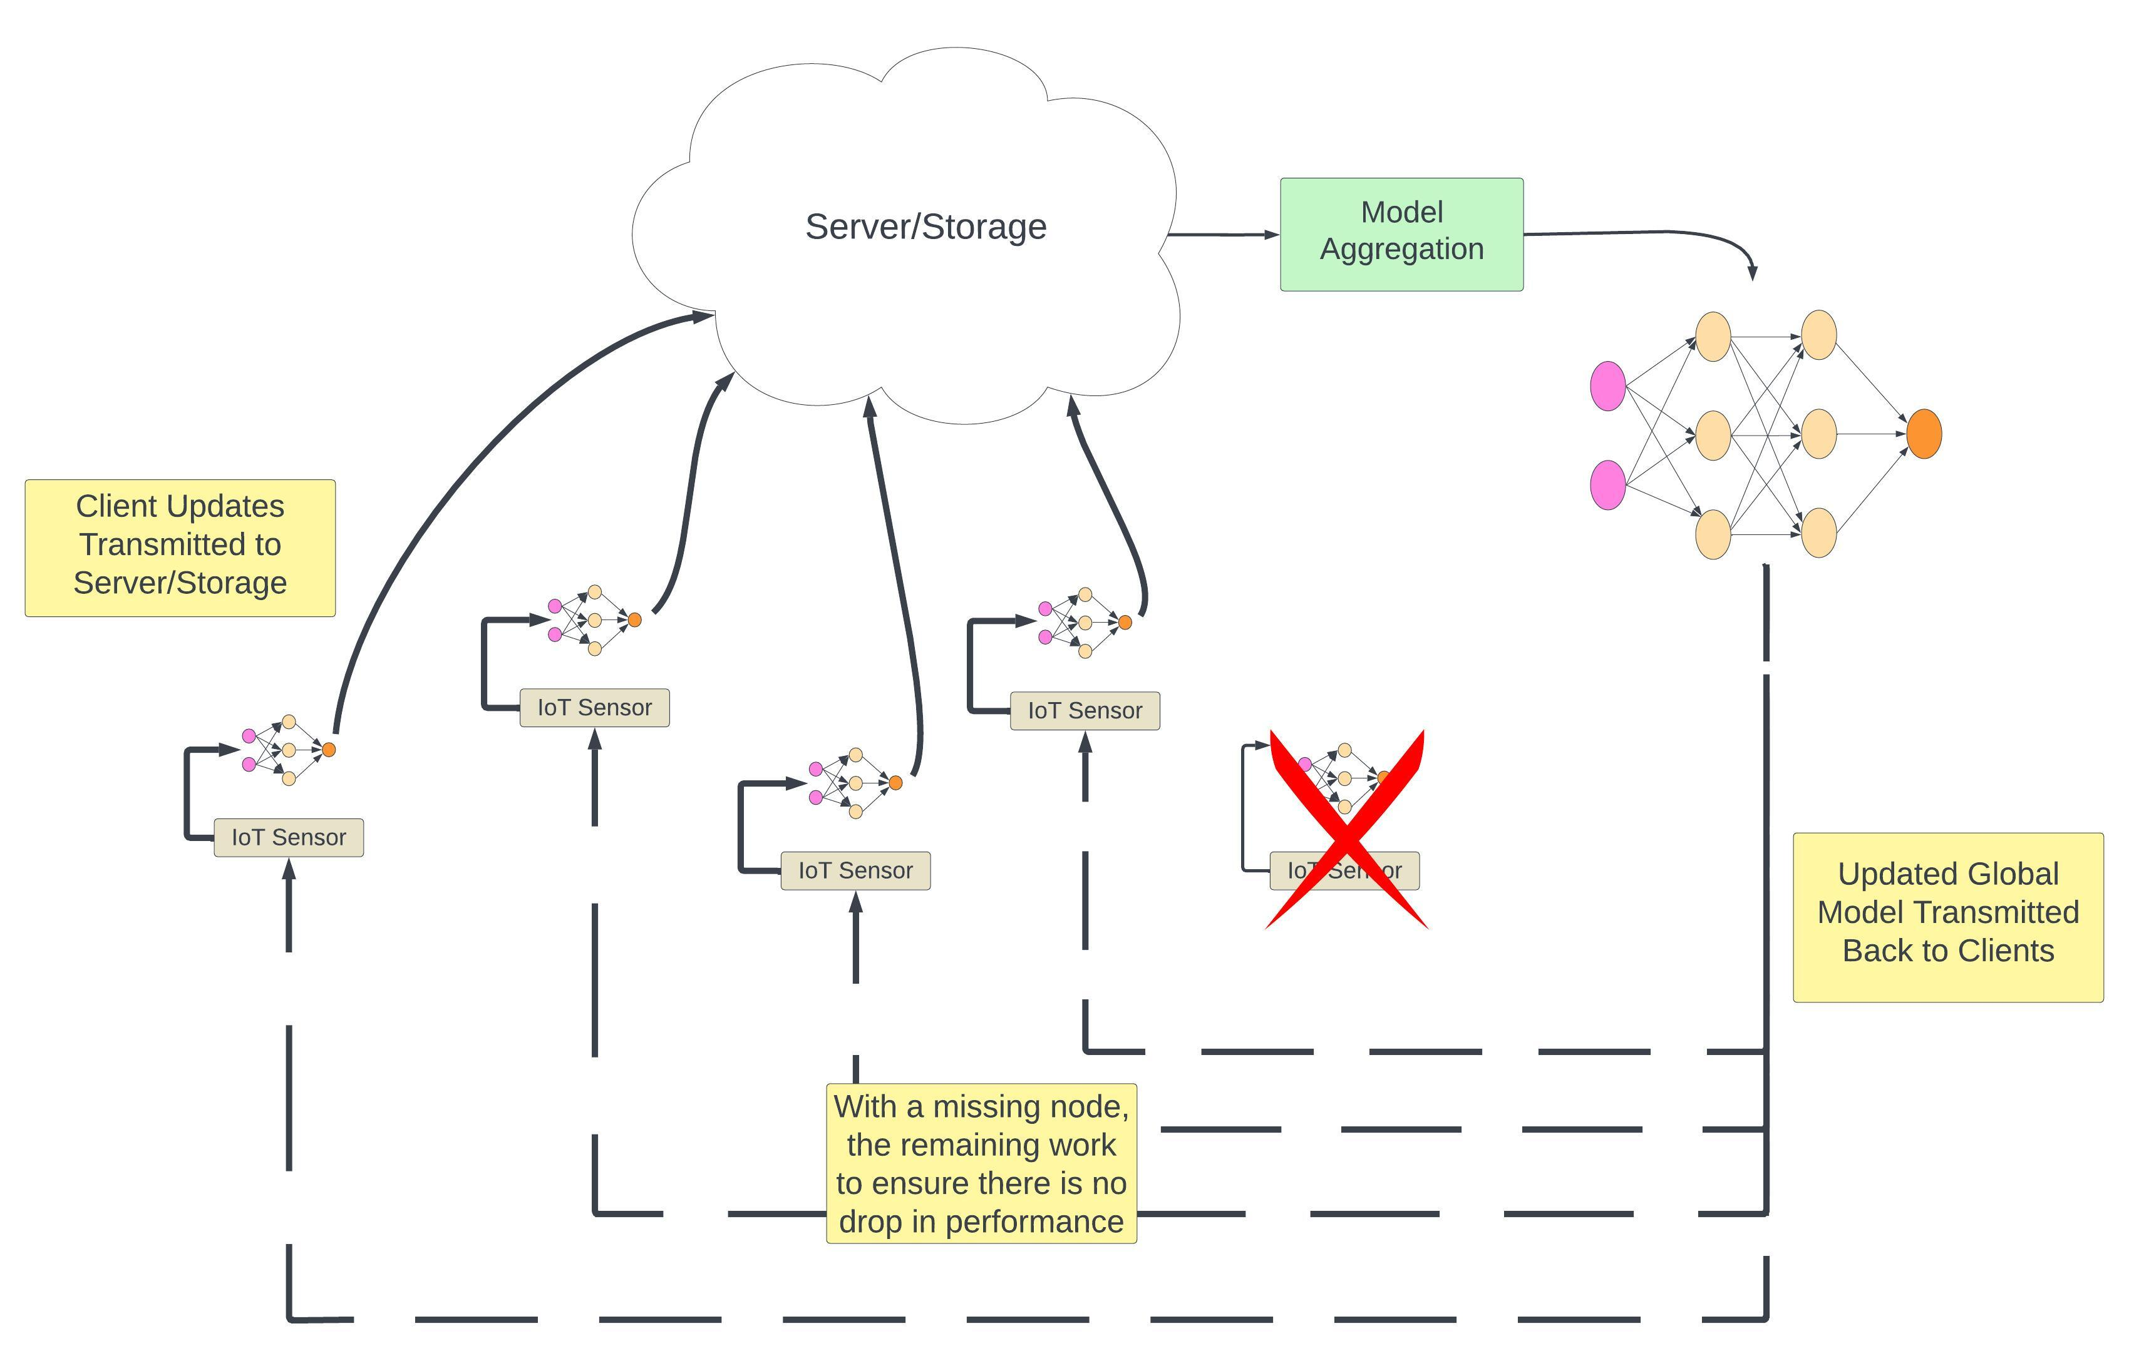
Federated Learning Diagram

Slide 10
Questions and What’s Next

Slide 11
Questions (Some specific, some general), and What’s Next
What is required for the 100/200-day review?
4-page report, presentation – but level of detail?
As a rule of thumb, what amount of reading should I aim for in a week?
Associated with this is writing more
Submitting abstract for NIBES?
What is the policy on the use of AI tools, specifically to assist with coding (e.g., Copilot)
AI tool for writing C test cases?

